Slide 1
RWANDA GENOCIDE

Slide 2
What is GENOCIDE?
The term "genocide" did not exist before 1944. It is a very specific term, referring to violent crimes committed against groups with the intent to destroy the existence of the group. Human rights, as laid out in the US Bill of Rights or the 1948 United Nations Universal Declaration of Human Rights, concern the rights of individuals.
https://www.ushmm.org/wlc/en/article.php?ModuleId=10007043

Slide 3
BUT...

Slide 4
In ancient times, it was common practice for victors in war to slaughter the men of a population they conquered. Arguably the first modern genocide took place in the 13th century, when heretics in medieval Europe were massacred during the Albigensian Crusade.
http://www.history.com/topics/what-is-genocide

Slide 5
SO SAD BUT IT HAPPENS :(

Slide 6
“Between April and June 1994, an estimated 800,000 Rwandans were killed in the space of 100 days.”
http://www.bbc.com/news/world-africa-13431486

Slide 7
Rwanda, Africa

Slide 8
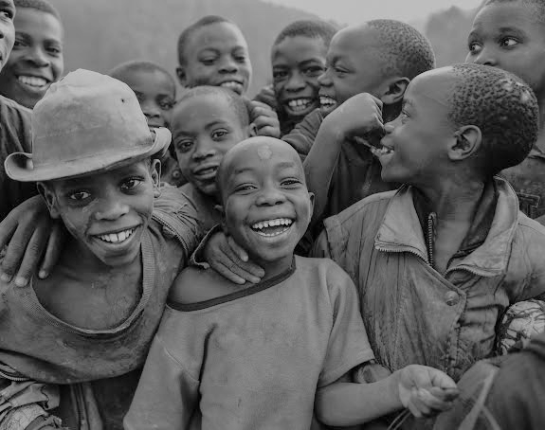
There are three major ethnic groups in Rwanda.

Slide 9
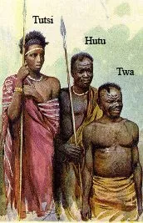
Twa
earliest settlers of Rwanda
originally lived off the land as hunters and gatherers
Ethnic minority accounting for only 1% of the population of Rwanda
continue to suffer discrimination and prejudice due to their pygmy ancestry
Notes:
But as the forests were cut down--first by the Hutu for farming and grazing, then by the Tutsi for grazing--the Twa population began to decrease. Today the Twa make up only 1% of the total population.
http://www.cotf.edu/ete/modules/mgorilla/mgethnic.html

Slide 10
Hutu
Physical Appearance
Dark skin
Stocky builds
share a common ancestry or origin with the Tutsis
largest ethnic group in Rwanda, making up 85-90% of the total population

Slide 11
Tutsi
Physical Appearance
Taller
Thinner
Lighter Skinned
second largest ethnic group in Rwanda accounting for 15% of the population.

Slide 12
Although the Tutsi dominated and controlled society, they constituted only a minority of the population.

Slide 13
The Tutsis established a pyramid-style political structure by the 15th century and reigned over Rwanda for several hundred years. The relationship between Tutsis and the ethnic groups were civil until approximately the 19th Century.

Slide 14
What happened in Rwanda on the 19th Century?
The Germans were the first to colonize Rwanda in 1894. They looked at the Rwandan people and thought the Tutsi had more European characteristics, such as lighter skin and a taller build. Thus they put Tutsis in roles of responsibility.
When the Belgian colonists arrived in 1916, they produced identity cards classifying people according to their ethnicity. The Belgians considered the Tutsis to be superior to the Hutus.
A Hutu revolution in 1959 forced as many as 300,000 Tutsis to flee the country
http://www.bbc.com/news/world-africa-13431486
Notes:
It wasn't until Europeans came to colonize the area that the terms "Tutsi" and "Hutu" took on a racial role.
Not surprisingly, the Tutsis welcomed this idea, and for the next 20 years they enjoyed better jobs and educational opportunities than their neighbours. Resentment among the Hutus gradually built up, culminating in a series of riots in 1959. More than 20,000 Tutsis were killed, and many more fled to the neighbouring countries of Burundi, Tanzania and Uganda.

Slide 15
What happened in Rwanda on the 19th Century?
When Belgium relinquished power and granted Rwanda independence in 1962, the Hutus took their place.

Slide 16
What happened?
The Rwandan genocide was a systematic campaign by the Hutu ethnic majority aimed at wiping out each and every member of the minority Tutsi group. The Hutu-controlled government and allied militias slaughtered between 800,000 and one million Tutsis before a Tutsi rebel group overthrew them. Over 100,000 Hutus were also killed, including both moderate Hutus killed by Hutu extremists and those killed by Tutsis in so-called "revenge killings."
The genocide was set into motion by the death of Rwandan President Juvénal Habyarimana. On April 6th, 1994, Habyarimana's plane was shot down by a missile of unknown origin. Government-aligned forces used (Hutu) Habyarimana's death as an excuse to begin a campaign of slaughter they had been planning for some time, and the genocide began on April 7th. It went on for about 100 days.

Slide 17
The story behind the Rwandan genocide begins with colonialism
The split between Hutus and Tutsis arose not as a result of religious or cultural differences, but economic ones. "Hutus" were people who farmed crops, while "Tutsis" were people who tended livestock. Most Rwandans were Hutus. Gradually, these class divisions became seen as ethnic designations.
Because cattle were more valuable than crops, the minority Tutsis became the local elite. By the time Belgium took over the land in 1917 from Germany (who took it in 1884), an ethnic Tutsi elite had been the ruling monarchy for quite some time.

Slide 18
The story behind the Rwandan genocide begins with colonialism
German and Belgian rule made the dividing lines between the groups sharper. This "divide and conquer" strategy meant supporting the Tutsi monarchy and requiring that all local chiefs be Tutsis, turning the Tutsis into symbols of colonial rule for the Hutu majority.
Post-independence, the resentment created by colonial divide-and-conquer bred violence. Seeing as Hutus were a large majority, they handily won the country's first elections in 1961, and the regime that followed was staunchly Hutu nationalist. Intermittent violence between Hutus and Tutsis became a feature of post-independent Rwandan

Slide 19
The Rwandan genocide was a pre-planned extermination campaign
The Rwandan genocide was a different class of violence altogether from what came before it. It wasn't just wartime violence; it was a directed, pre-meditated attempt to eliminate an entire people.

Slide 20
There's a strong case the world could have stopped it
Unlike earlier mass killings, such as the Holocaust, the international community had advance evidence of the coming genocide. Once it launched, they had evidence of where it was going, and still did nothing.
Canadian General Romeo Dallaire, who commanded the small UN observer force tasked with implementing the peace agreement, heard the Hutus were planning genocide in January 1994. He informed the higher-ups at the UN, but wasn't permitted to act.
Even after the genocide began, and the evidence of slaughter became undeniable, the international community did nothing. The United States actively discouraged the UN Security Council from authorizing a more robust deployment.
Notes:
In hindsight, there's a good chance the UN could have done something. General Dallaire believes that, with an extra 5,000 troops and a stronger UN mandate, he could have saved "hundreds of thousands." The failure to intervene, which Bill Clinton calls one of the greatest regrets of his presidency, catalyzed the modern movement in favor of humanitarian military intervention to prevent genocide. Two major Obama administration officials — Susan Rice and Samantha Power — became converted to the cause of humanitarian intervention in part due to America's inaction in Rwanda.

Slide 21
It ended only after Tutsi rebels defeated the government
The day after the genocide began, the Tutsi rebel group RPF, led by Paul Kagame, launched an offensive aimed at toppling the Rwandan government. In about one hundred days, the RPF defeated the government forces. Kagame, a Tutsi, became the country's leader in all but name: a Hutu was technically made president while Kagame was vice president, but Kagame controlled the army.

Slide 22
How is Rwanda today?
“Rwanda today is a much better place, but still suffers from authoritarianism and violence.”
Notes:
Today, Kagame still runs Rwanda — he's officially been president since 2000. His record has been extraordinarily mixed; he's done an incredible job helping rebuild life in Rwanda since the genocide, but he's also sponsored violence around the region, killed political dissidents, and consolidated authoritarian power.
Start with the good. Rwanda's life expectancy has doubled in the past decade, and child mortality and HIV rates have plummeted. The Rwandan economy has grown at a staggeringly high 8 percent rate since 2008, making it, by one assessment, the most desirable African country to invest in.
However, Kagame's government is described by his critics as an ethnic autocracy. Tutsis (who make up 10 percent of the government) staff most official positions, especially in the military. Kagame has supported murderous foreign militias, like the M23 in the DRC, and may have been complicit in revenge killings.

